Slide 1
MOPS
Chemistry & Biology Project

Slide 2
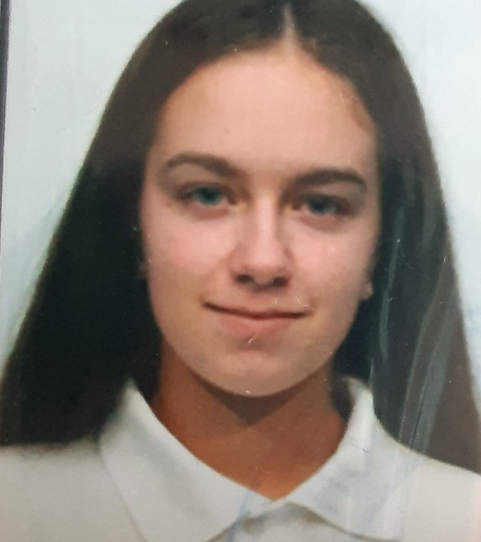
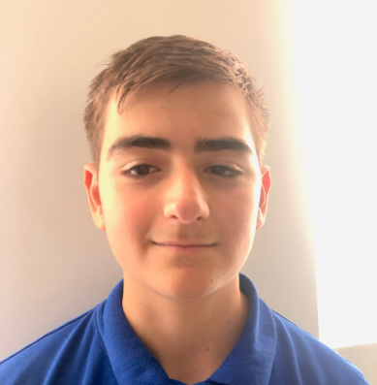
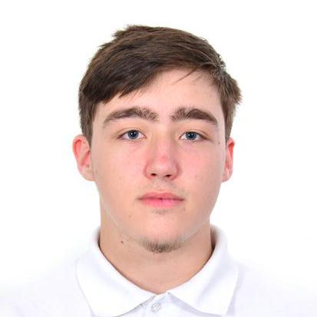
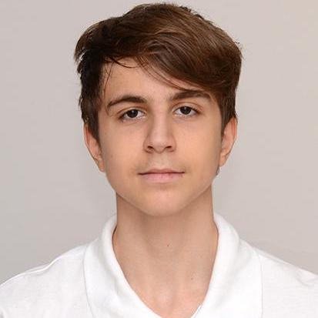
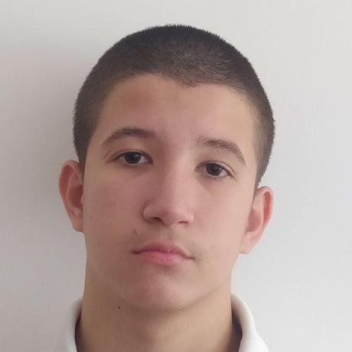
OUR TEAM
Valeria Yaneva
Scrum Trainer
Maxim Marinov
Backend
Stefan Hristov
Backend
Petar Matsaliev
Backend
Dani Gramatikov
Designer

Slide 3
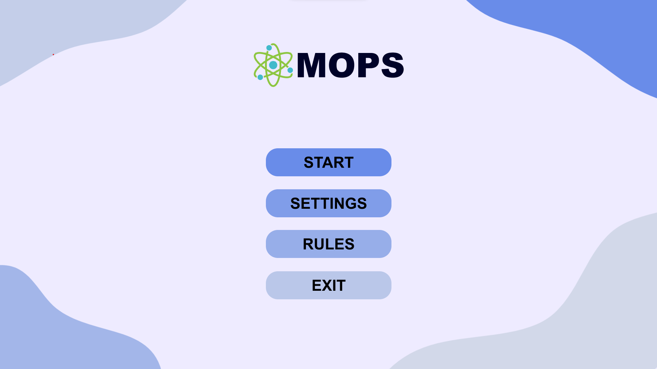
OUR IDEA
We had more than 20 days to build a project about chemistry from scratch. The idea was to make an ordering simulator for chemistry elements with the aim of it being to learn more about the subject.

Slide 4



STAGES OF DEVELOPMENT
1.
3.
2.

Slide 5













USED PROGRAMS

Slide 6
LET’S JUMP TO THE PROJECT!

